Slide 1
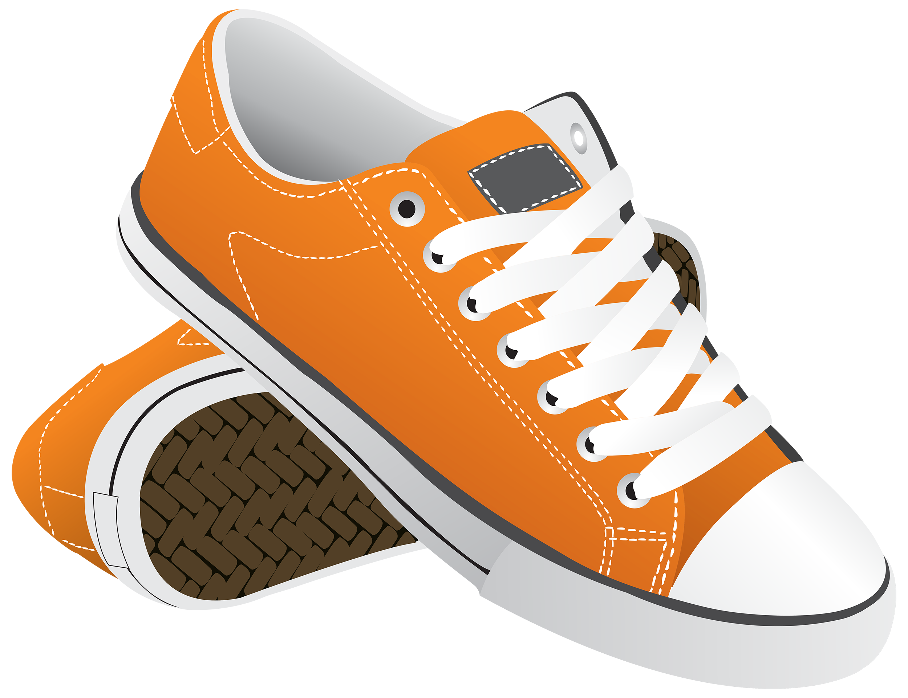
Trendy Feet - Solution
Year 11 Accounting & Finance 2023

Slide 2
Question 1 – Depreciation and Sale of Asset
On 1 September 2026 Trendy Feet, a manufacturer of footwear, purchased plant and equipment. The asset was transported to Perth.
The following payments were associated with the purchase of the plant and equipment before GST.

Slide 3
Cost of Asset for Depreciation Purposes = $39 000
Therefore using straight line depreciation formula:
1st Sept 2026 – 30 June 2027 = 10 months
Depreciation expense: ($39,000 - $5,400) / 7 = $4,800
Therefore, ($4,800 / 12) * 10 = $4,000
1st July 2027 – 30 June 2028 = 12 months
Depreciation expense: ($39,000 - $5,400) / 7 = $4,800
1st July - 31st October 2028 = 4 months
Depreciation expense: ($39,000 - $5,400) / 7 = $4,800
Therefore, ($4,800 / 12) * 4 = $1,600

Slide 6
Depreciation Expense
1 600

